Slide 1


Analysis of Alcohol-Attributed Mortality in the United States (2015-2019)
BY
NAME: DEBORAH ADEDIGBA A.
STUDENT NO: Q102026038
COURSE: COM 725

Slide 2
Introduction
Alcohol consumption causes immediate and lasting health issues, resulting in 95,000 preventable deaths annually in the US. (ARDI,CDC).
Objectives of the study:
Identify and Characterize Patterns and Trends
Explore Demographic Disparities
Investigate Causes and Risk Factors
Importance of Study:
Health Impact
Prevention and Education
Health Equity

Slide 3
Data and Methodology
Data Source and Data Preparation
Alcohol-related disease impact data from the CDC website between 2015-2019.
Data cleaning involved the removal of aggregated data and unnecessary features. Feature selection techniques were applied to identify important features.
Machine Learning Models
In this study, we used diverse machine learning models to forecast alcohol-related disease outcomes, assessing their performance through metrics like MSE, MAE, and R-squared. Based on factors using:
Support Vector Regression (SVR)
Gradient Boosting
Random Forest
XGBoost
XGBoost consistently outperforms the other models across all categories based on the evaluation metrics.

Slide 4
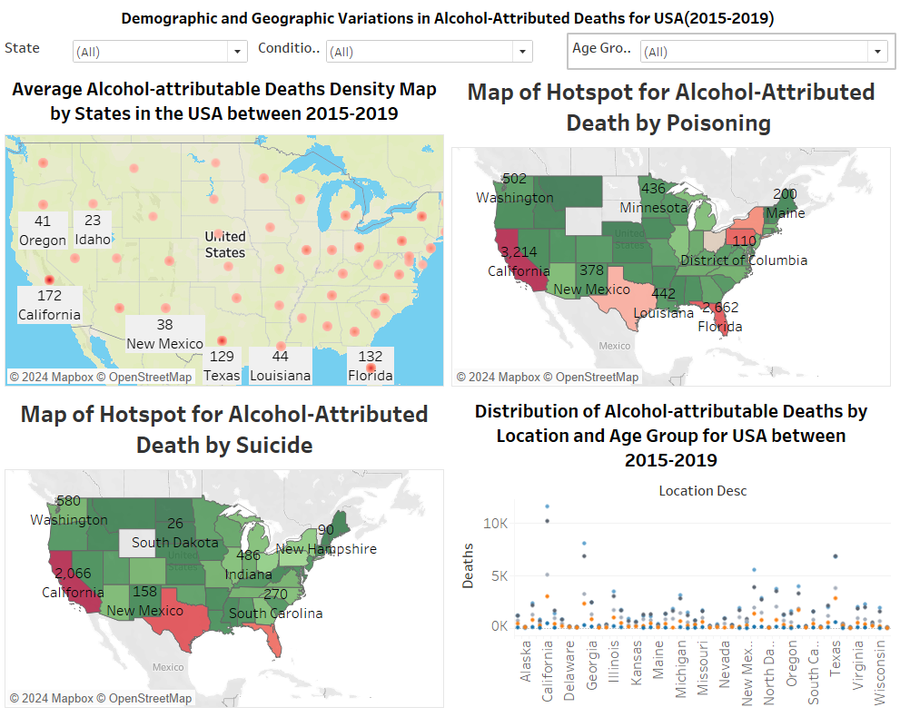

Findings - Demographic and Geographic Insights
California and Florida exhibit high average numbers of deaths, whereas Idaho and Oregon have relatively low numbers.
States such as California, Florida, Texas, New York, and Pennsylvania are hotspots for alcohol-attributed deaths due to poisoning.
Similarly, states like California, Florida, and Texas are hotspots for alcohol-attributed deaths by suicide.
In California, the age group with the highest number of deaths is 65 and above, whereas in Texas, it is the age group of 50-64. Across all locations, deaths among ages 0-24 are low.

Slide 5
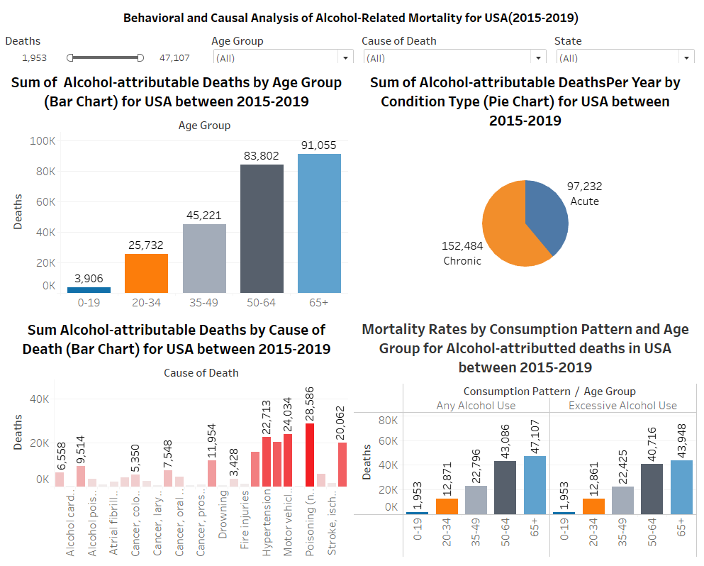
Findings - Causes and Conditions
The deaths attributed to alcohol are quite high for the age group of 50 and above, but relatively low for the age group of 0-19, totalling 3,906.
The sum of chronic condition types is 152,484, which is higher than acute conditions.
The prominent causes of death attributed to alcohol, as shown, are poisoning and motor vehicle accidents, while pneumonia and alcohol cardiomyopathy are fewer common causes.
The difference in alcohol consumption shows little or no variation in the number of deaths across the age groups.

Slide 6
Implications and Recommendations
Implications:
Understanding Patterns and Trends and Identifying Risk Factors:
Our analysis revealed significant patterns and trends from 2015 to 2019, shedding light on alcohol-related mortality rates.
Demographic Disparities:
Our findings underscored demographic disparities in alcohol-related mortality rates, particularly in states like California, Texas, and Florida, which emerged as hotspots for such deaths. Conversely, states like Idaho and Oregon exhibited lower mortality rates.
Future Discussions:
Use of Timeseries data can provide a comprehensive understanding of alcohol-related mortality trends over time. Additionally, exploring socio-economic factors such as income and education levels can uncover further risk factors and disparities.

Slide 7
Conclusion
In summary, our study has effectively analysed alcohol-related deaths in the US from 2015 to 2019. We've identified patterns, demographic disparities, and key risk factors influencing mortality rates. Our findings underscore the need for targeted interventions and evidence-based policies to reduce alcohol-related harm.
We recommend ongoing research to track trends, explore additional risk factors, and evaluate intervention strategies. Longitudinal studies and collaboration are essential for addressing the complexities of alcohol-related mortality.

Slide 8
Thanks for Listening

